Slide 1
Project 1
2025 NFL Combine
Running Backs vs Wide Receivers Athleticism
Minh Truong
Mallie Lange

Slide 2
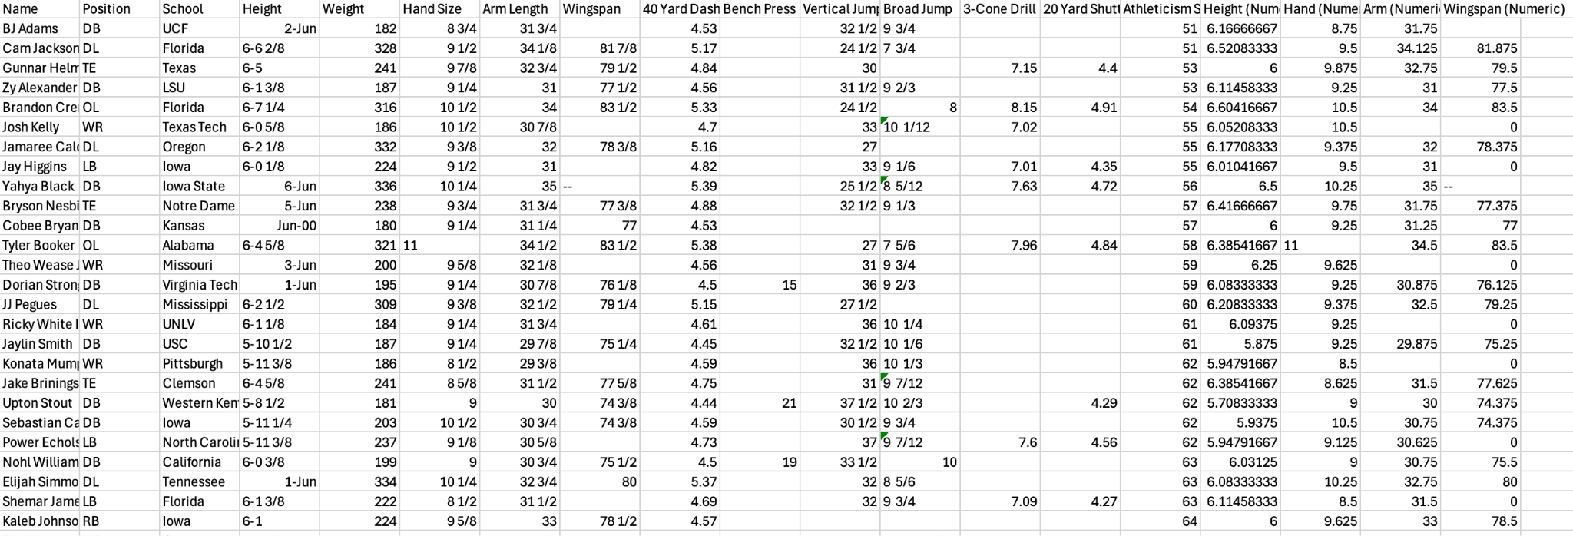
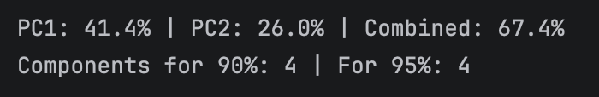
Dataset Information + PCA Concept + Application
The dataset chosen is sourced from kaggle.com.
There are 325 players each with 18 different variables including: Name, Position, School, Height, Weight, Hand Size, Arm Length, Wingspan, 40 Yard Dash, Bench Press, Vertical Jump, Broad Jump, 3-Cone Drill, 20 Yard Shuttle, Athleticism Score, Height (Numeric), Hand (Numeric), Arm (Numeric), and Wingspan (Numeric).
PCA = Principal Component Analysis
PCA stands for principal component analysis which is a way to reduce the linearly independent vectors without drastically losing information. The data with a lot of features is analyzed to find the principal components, a few of the principal components are chosen to reduce dimensionality while keeping the information meaningful.
Applying PCA to the NFL Combine Dataset
PC1 represents the first principal component which is body size (including weight, height and hand size)
PC2 represents the second principal component which is speed, in this case how fast the player can run the 40 yard dash
The table below represents that that PC1 explains 41.4% of the dataset’s variance whereas PC2 explains about 26% of the dataset’s variance, and combined PC1 and PC2 explain 67.4% of the dataset’s variance.
Notes:
The dataset chosen is sourced from kaggle.com.
The dataset has 325 players and 18 different variables including: Name, Position, School, Height, Weight, Hand Size, Arm Length, Wingspan, 40 Yard Dash, Bench Press, Vertical Jump, Broad Jump, 3-Cone Drill, 20 Yard Shuttle, Athleticism Score, Height (Numeric), Hand (Numeric), Arm (Numeric), and Wingspan (Numeric).
PCA = Principal Component Analysis
PCA stands for principal component analysis which is a way to reduce the linearly independent vectors without drastically losing information. The data with a lot of features is analyzed to find the principal components, a few of the principal components are chosen to reduce dimensionality while keeping the information meaningful.
Applying PCA to the NFL Combine Dataset
PC1 represents the first principal component which is body size (including weight, height and hand size)
Running backs (RBs) score higher on PC1, while wide receivers (WRs) score lower
PC2 represents the second principal component which is speed, in this case how fast the player can run the 40 yard dash
Players with faster times score lower on PC2
The table below represents that that PC1 explains 41.4% of the dataset’s variance whereas PC2 explains about 26% of the dataset’s variance, and combined PC1 and PC2 explain 67.4% of the dataset’s variance.

Slide 3
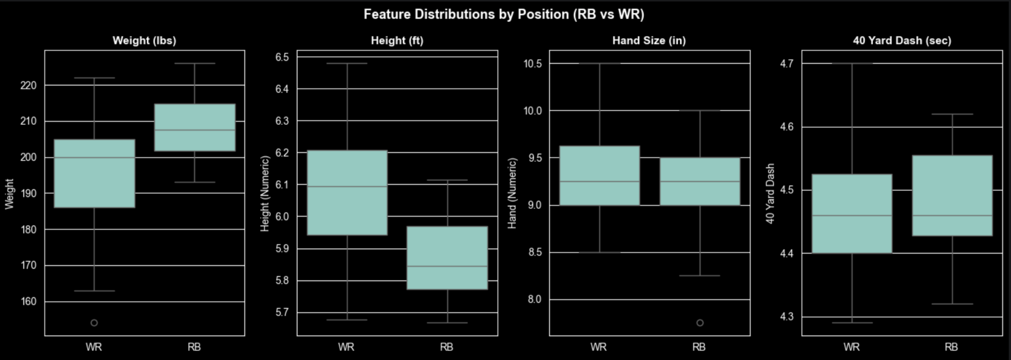
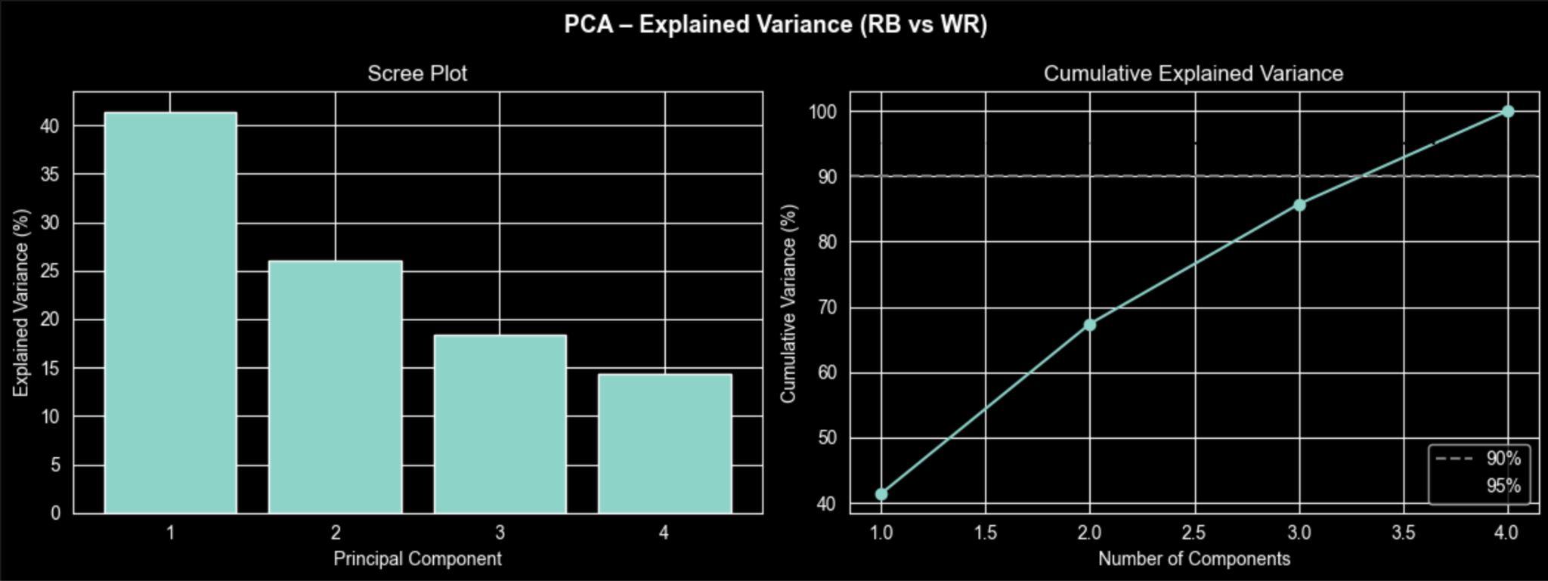
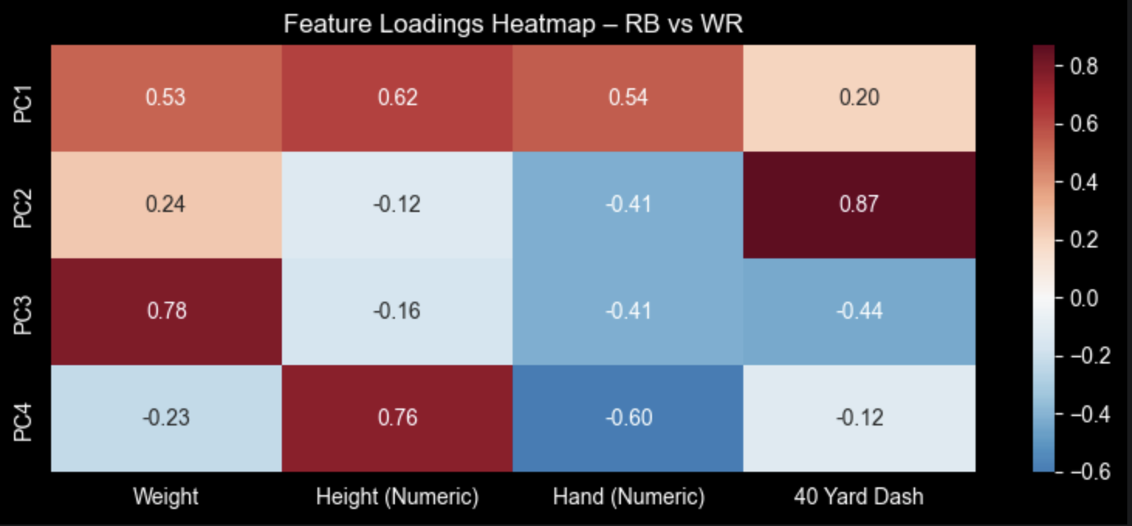
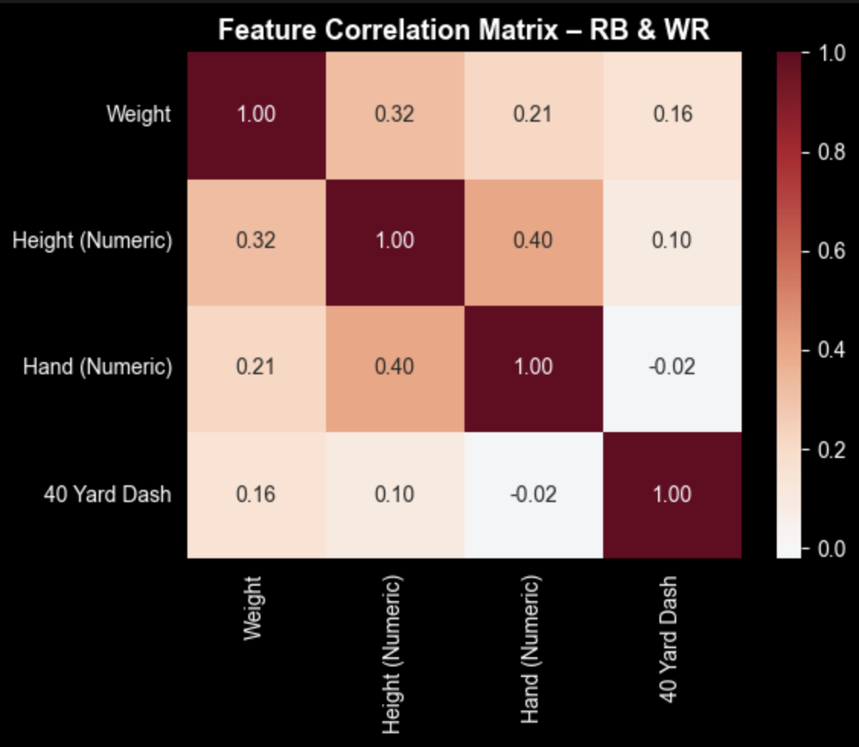
Graphs + Visualization
Graph #1
Graph #3
Graph #4
Graph #2
Notes:
Graph #1: Feature Distribution by Position (RB vs WR)
These box plots compare Wide Receivers (WR) and Running Backs (RB) across four physical and performance features including weight (pounds), height (feet), hand size (inches) and 40 yard dash time (second).
Graph #2: Feature Correlation Matrix - RB & WR
This feature correlation matrix shows how strongly each pair of variables moves together across RB and WR players. Values range from -1 to 1, if the value is positive that means the features increase together, if the value is negative that means one increases while the other decreases and if the value is near zero that means there is little or no relationship between the features. In this matrix we can see Height & Hand Size have a value of 0.4 meaning they have a strong relationship so taller players tend to have larger hands.
Graph #3: PCA - Explained Variance (RB vs WR)
The scree plot shows that PC1 explains the most variance in the dataset (~41%), followed by PC2 (~26%), PC3 (~18%), and PC4 (~14%), meaning the first two components capture the main patterns in the data. The cumulative variance plot shows that PC1 and PC2 together explain about 67% of the information, while adding PC3 increases this to about 85%, and all four components capture 100%. Overall, most meaningful variation is explained by the first two components, with PC3 adding useful detail and PC4 contributing the least.
Graph #4: Feature Loadings Heatmap - RB vs WR
The feature loadings heatmap shows how each original feature contributes to each principal component (values from −1 to 1). Positive loadings increase a player’s score on a PC, negative loadings decrease it, and near-zero loadings have minimal effect. In this case, we see PC1 represents body size (bigger, slower players score higher), while PC2 represents speed (measured by the 40-yard dash). The heatmap gives meaning to otherwise abstract PCA components so the results can be interpreted. The colors red (positive) show that feature pushes a player's score higher on that PC, blue (negative) show that feature pushes a player's score lower on that PC, lastly white/neutral show that feature has little influence on that PC.

Slide 4
Conclusion + Key Takeaways
PC1 = Body Size Axis
41.4% variance.
Weight, Height & Hand Size
RBs score higher (heavier, more compact frame)
PC2 = Speed Axis
26.0% variance.
40 Yard Dash time
Separates the fastest players regardless of size
Speed is Universal
RBs average 4.48 sec, WRs avg 4.46 sec
Elite straight-line speed is a non-negotiable baseline at both skill positions
Partial Separation
RBs and WRs overlap in PCA space
Reflects modern NFL hybrid players who can line up at multiple positions and having overlapping skill sets
4 Features = 4 PCs = 100%
All components needed for 90% retention
There is low redundancy in the features because each scouting metric contributes something unique to the analysis
PCA distilled 4 scouting measurements into 2 interpretable dimensions: SIZE and SPEED. This reflects the general athletic traits that NFL teams look for at skill positions.
Notes:
Key takeaways:
PC1, the player’s size explains 41.4% of the dataset’s variance
PC2, the speed of the 40-yard dash, explains about 26% of the dataset’s variance
Speed is Universal: The nearly identical average 40 Yard Dash times (4.48 vs 4.46 sec) is the most compelling result because it challenges the assumption that WRs are "the fast ones." Elite speed is simply required for both positions.
The partial separation in PCA space is a meaningful finding. If RBs and WRs were perfectly separated, it would suggest they are completely different athletes. The overlap confirms the modern NFL reality of positionless skill players.
All 4 features/components are needed to reach 90% variance, which tells us the 4 scouting features we chose are genuinely independent of each other and each one captures something the others do not.

